Slide 1

Notes:
Hi, I’m [name], thanks for joining us today. I’d like to share some information from Sheffield is Sweet Enough. This is an initiative from Sheffield City Council that aims to help local families make healthy food choices.

Slide 2
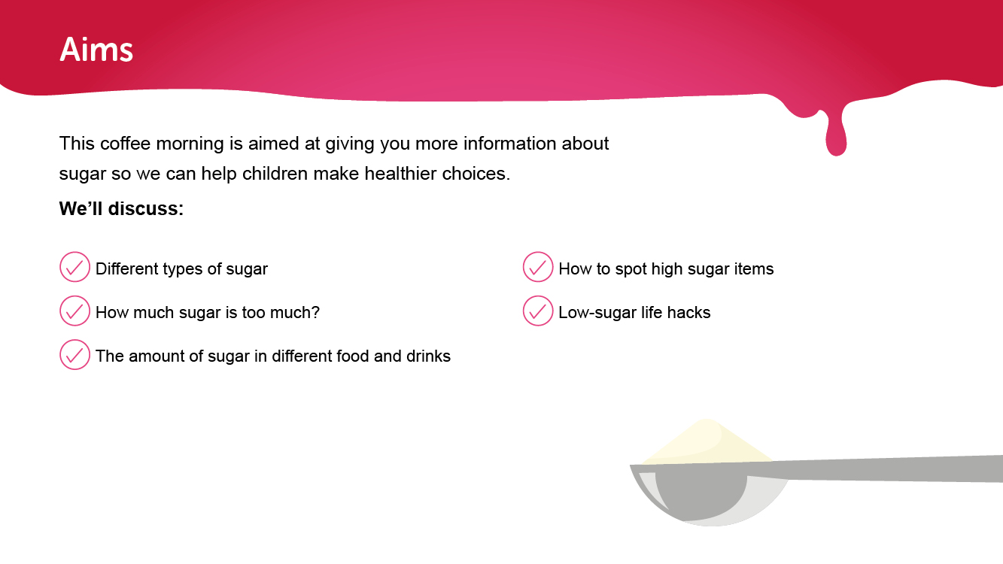
Notes:
During this coffee morning, we want to give you more information on sugar and some top tips to encourage children to make healthy choices from a young age.
We’ll discuss:
Different types of sugar
How much sugar is too much
The amount of sugar in different foods and drinks
How to spot high sugar items and useful tips on reducing sugar

Slide 3
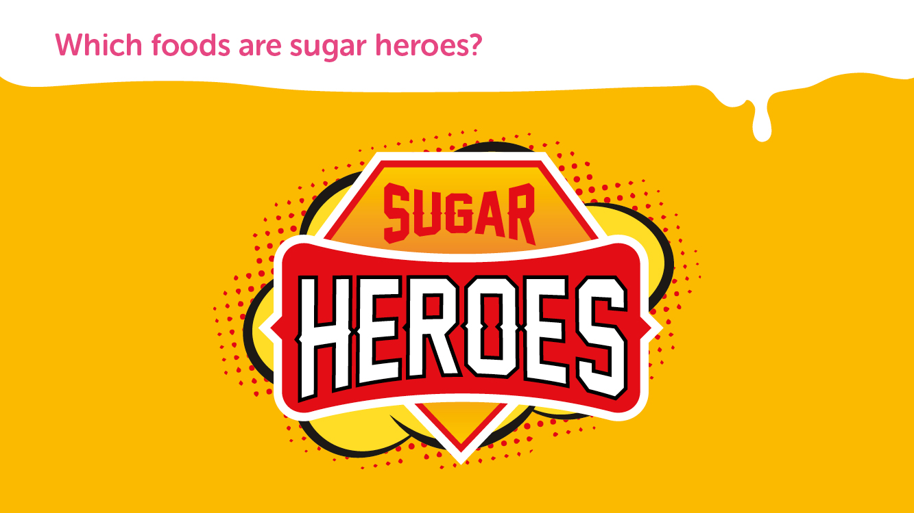
Notes:
Food and drinks that are healthy and don’t contain too much sugar are our children’s sugar heroes.

Slide 4
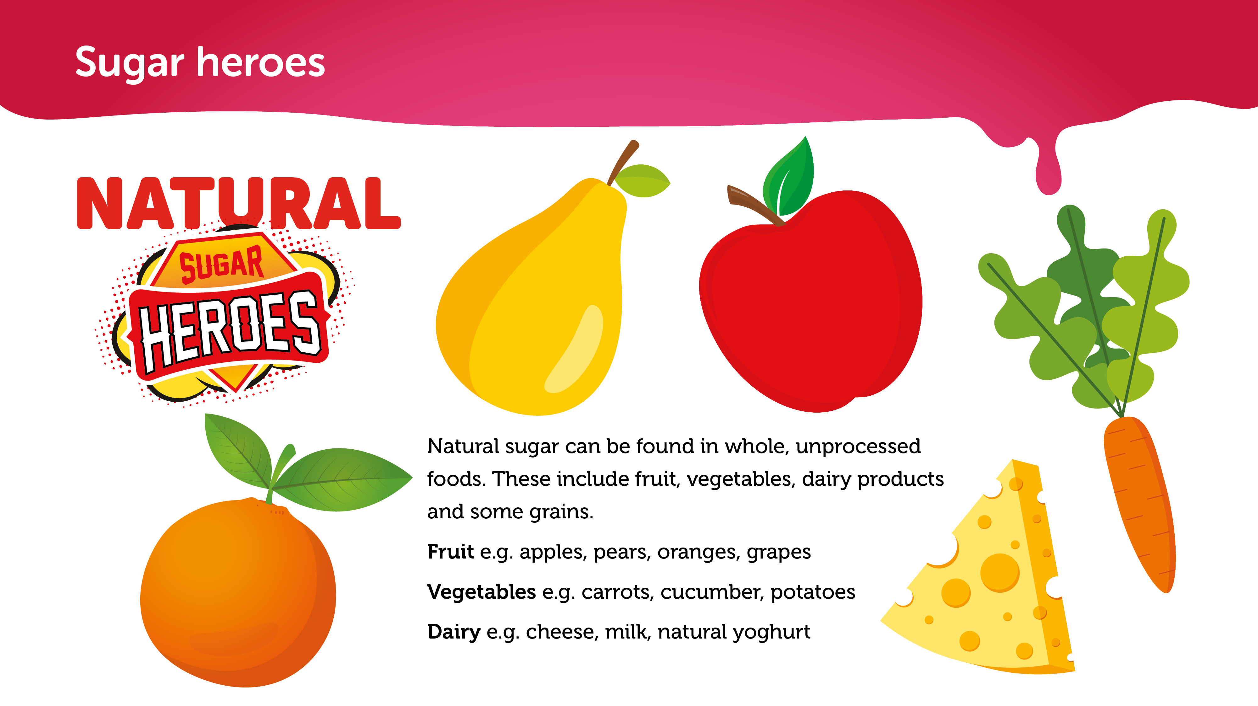
Notes:
Our children’s sugar heroes are foods like fruit, vegetables and dairy products that contain natural sugars.

Slide 5
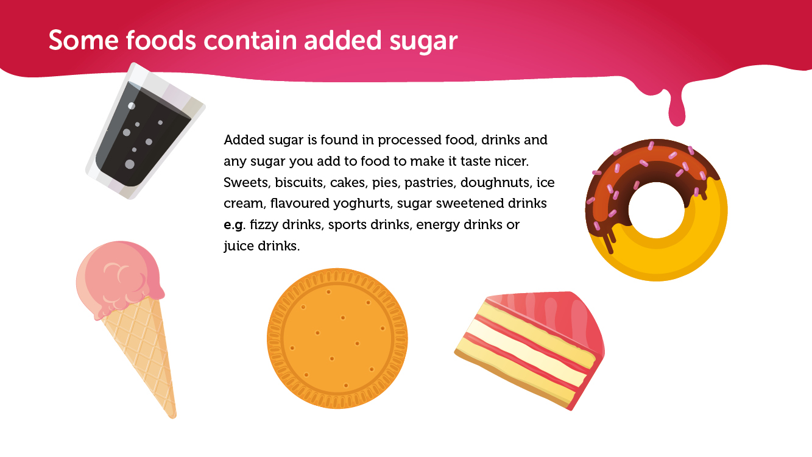
Notes:
Added sugar is any sugar you add to food and drinks to make them taste better.
You find added sugar in sweets, biscuits, cakes, pies, pastries, doughnuts, ice cream, flavoured yoghurts and sugar sweetened drinks, such as fizzy drinks, sports drinks, energy drinks or juice drinks.

Slide 6
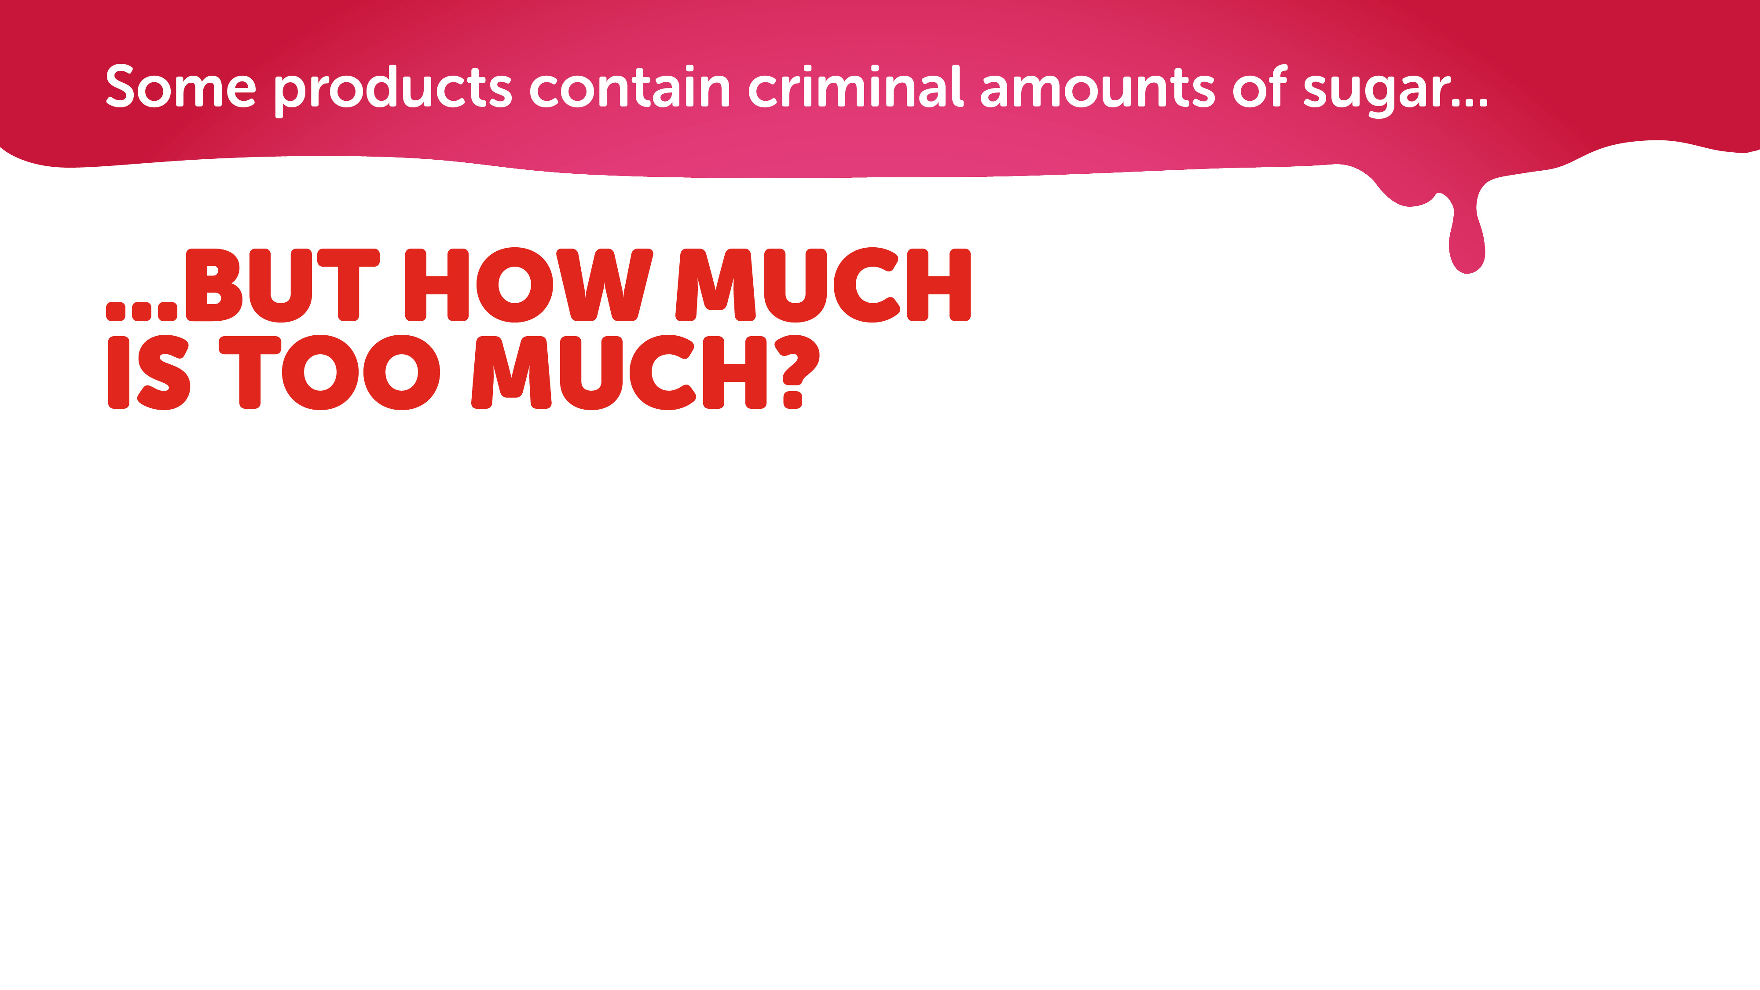

NHS recommends a maximum daily limit:
Babies and toddlers 0g per day
= 0 teaspoons = no sugar at all
Children aged 4-6 19g per day
= 4.5 teaspoons
Children aged 7-10 24g per day
= 5.5 teaspoons
11+ and adults 30g per day
= 7 teaspoons
Notes:
So, we know some food and drinks contain added sugar which isn’t healthy for us.
But how much sugar children are allowed to have in a day?
It might surprise you to know that babies and toddlers should have no added sugar at all.
Children aged 4 to 6 should have no more than 4.5 teaspoons of sugar per day
Children aged 7 to 10 should have no more than 5.5 teaspoons of sugar per day
And anyone over the age of 11 should have no more than 7 teaspoons of sugar per day

Slide 7
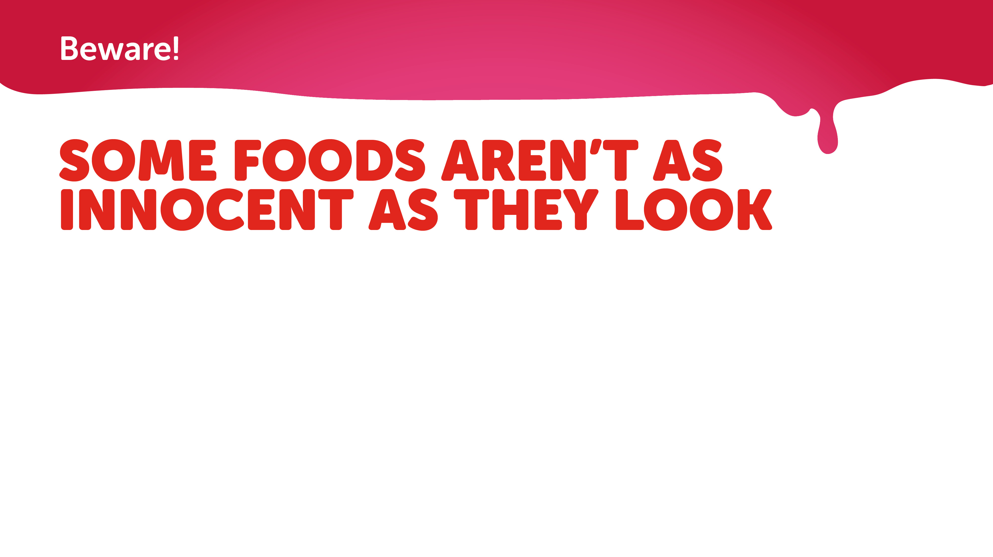
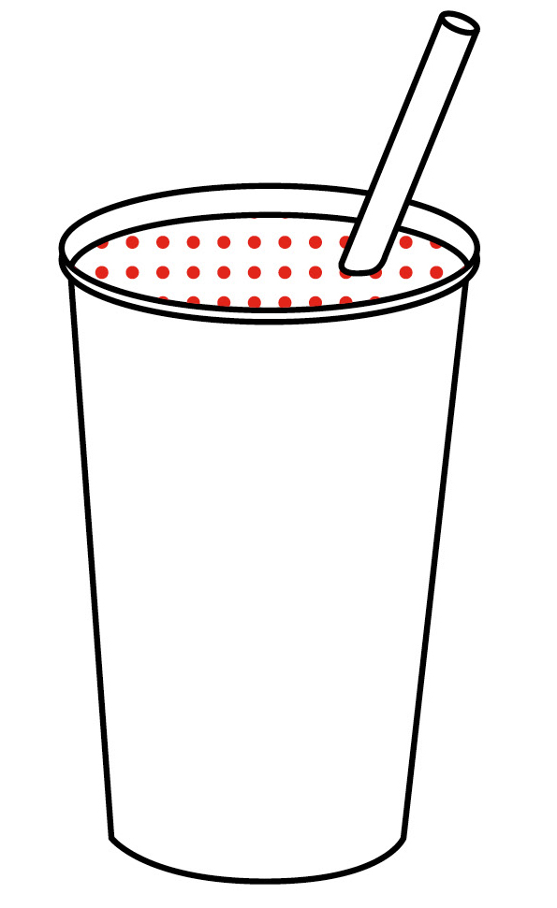
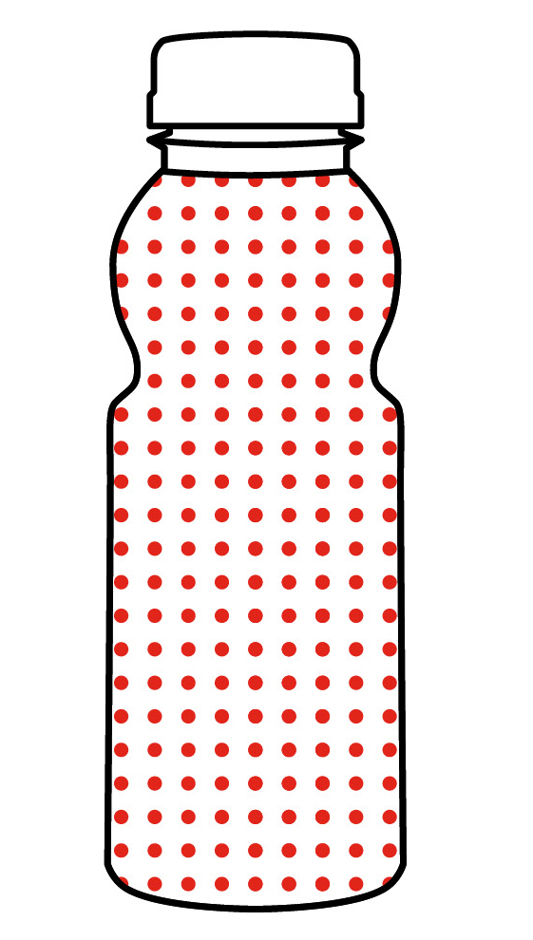
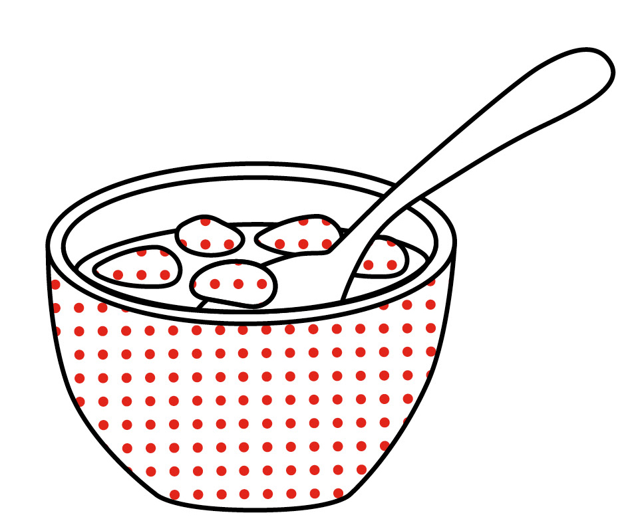
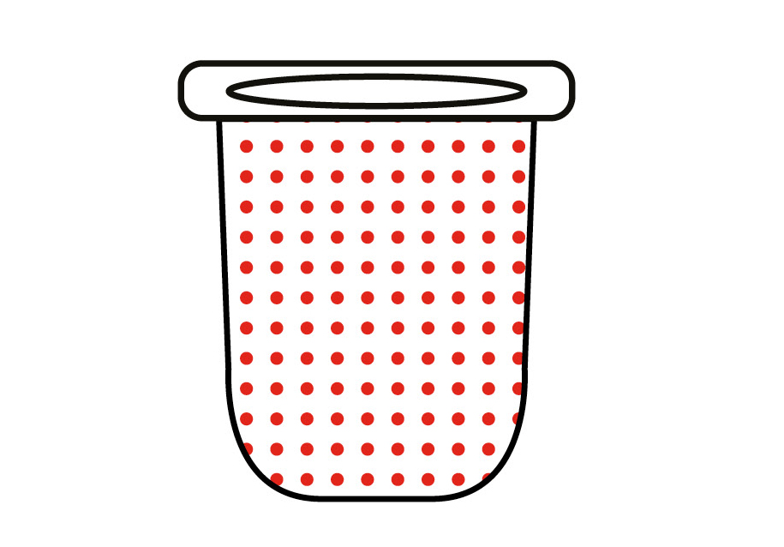
There are some foods that seem healthy,
but actually contain a high amount of sugar
Sweetened low-fat yoghurt
6 teaspoons
Fruit smoothie
4 teaspoons
Flavoured water
7 teaspoons
Added-sugar cereal
6 teaspoons
Notes:
Some foods may look healthy but actually they contain a lot of sugar and children may end up consuming more than the recommended maximum daily limit.
Foods with a surprising amount of sugar include low-fat yoghurt, fruit smoothies, flavoured water and sugary cereals.

Slide 8
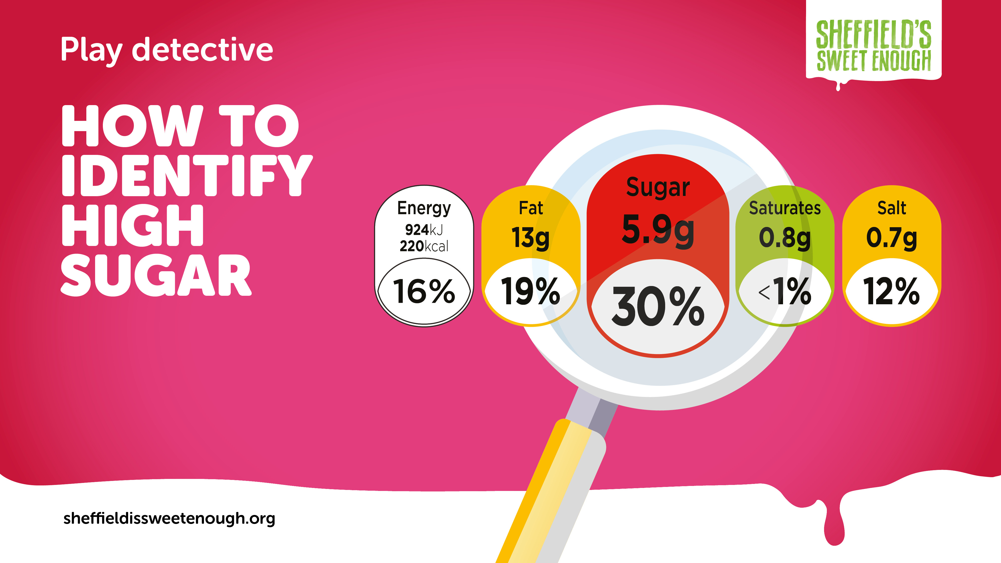
Notes:
Most items of food and drink we buy from the supermarket have a traffic light system on the front. It can be useful to teach children about this from an early age so they can easily see which items are their sugar heroes by asking them to look for items that are mostly green.

Slide 9
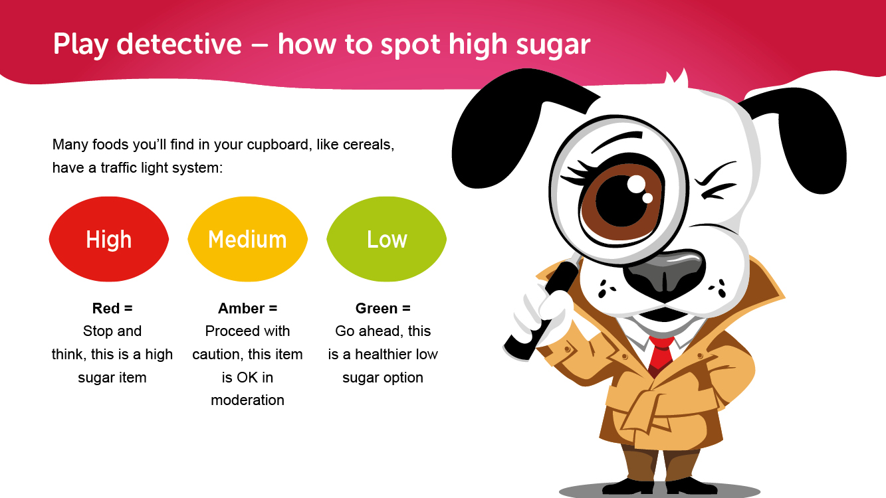
Notes:
The traffic light system makes it easy to spot which food and drink are sugar heroes and which to consume in moderation.
Red means stop and think, this is a high sugar item
Medium means be careful, you shouldn’t eat too much of this
And Green means go ahead, this is a healthier low sugar option
You can show your child some of the foods in your cupboard and point out the sugar heroes.

Slide 10
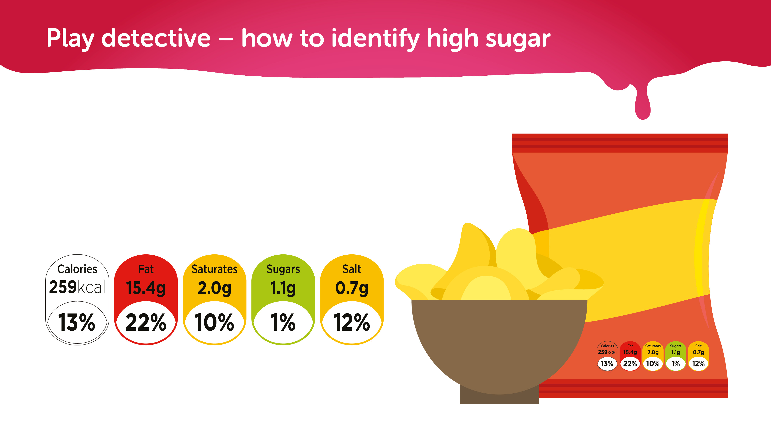
Bear in mind, some low sugar items, such as crisps,
are high in fat, which is also bad for our health. Low
sugar, low salt, low fat is always the healthiest option.
Always check the traffic light system for other key ingredients that might be red or amber.
Notes:
Bear in mind, some low sugar items, such as crisps, are high in fat, which is also bad for our health. Low sugar, low salt, low fat is always the healthiest option. Always check the traffic light system for other key ingredients that might be red and amber.

Slide 11
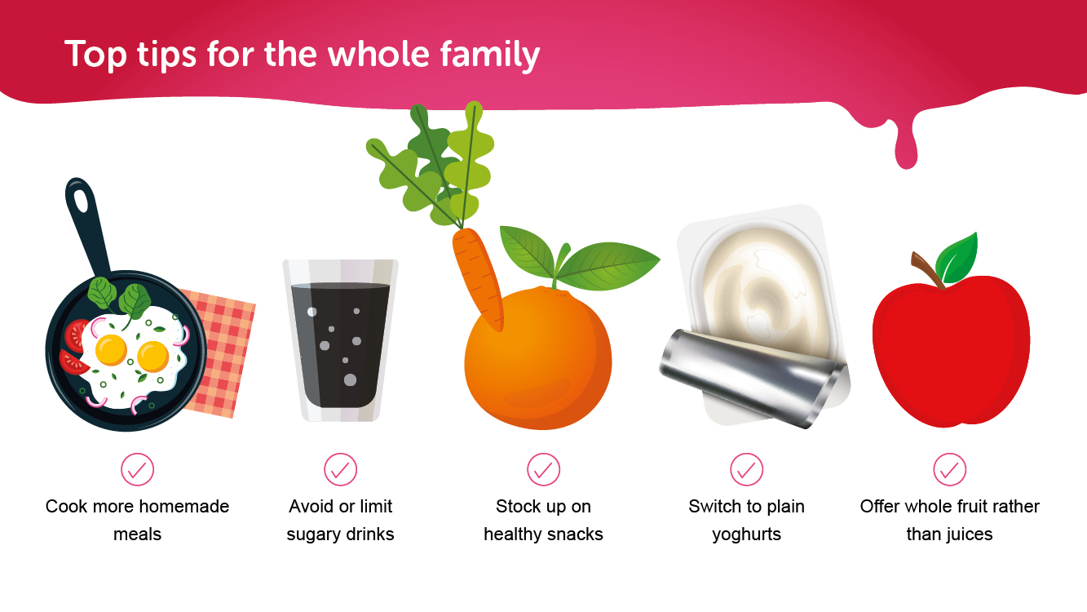
Notes:
As well as selecting healthy options when you shop, there are things you can do as a family to help reduce the amount of sugar children consume.
Cook more homemade meals – this helps to reduce the amount of added sugar in meals
Avoid or limit sugary drinks – stick to water or milk rather than juice boxes or fizzy drinks
Stock up on healthy snacks – give them healthy finger foods such as rice cakes and cooked vegetable pieces
Switch to plain yoghurts – Try Greek yoghurt mixed with fruit pieces instead of sweetened yoghurts
Offer whole fruit instead of juices – Whole pieces of fruit contain less sugar and more fibre than juices and smoothies

Slide 12
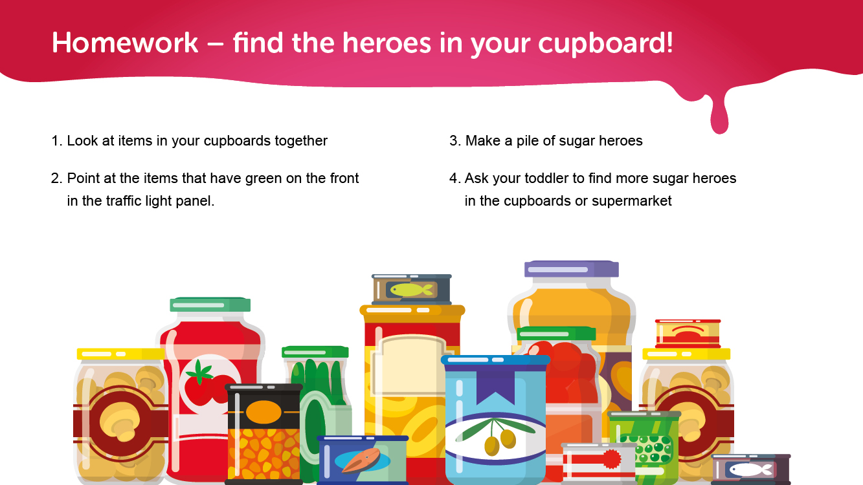
Notes:
There are some simple games you can play with your toddler at home and in the supermarket to help them spot sugar heroes.
Look in your cupboards together and pick out some products with the traffic light system on the front.
Ask your toddler to point to items with green on the front and make a pile of sugar heroes.
Next time you visit the supermarket together see if they can spot any more items with green on the front and put them in your basket.
You can do this with fruit and vegetables as well, asking them to pick green coloured items that they think are heroes e.g. cucumbers

Slide 13
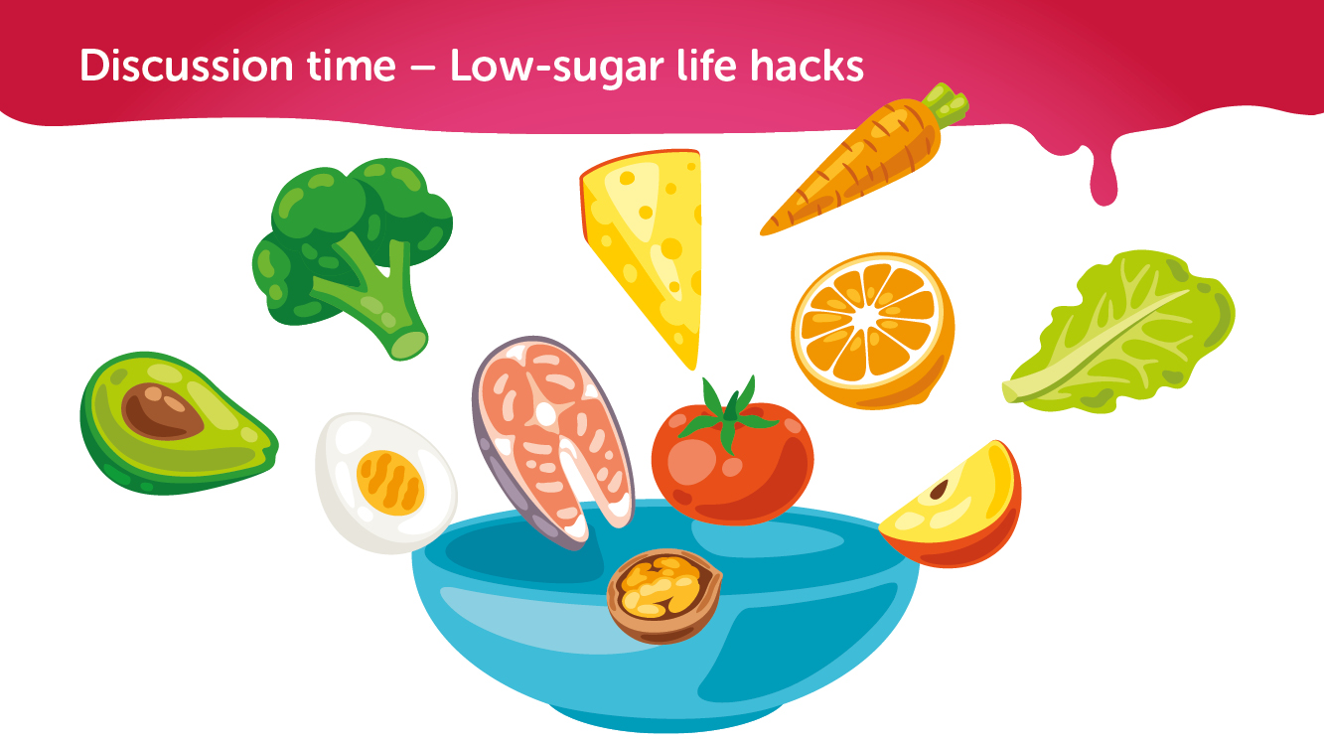
Notes:
To finish off the session I’d like to invite you all to share your low-sugar life hacks with the group.
Here’s one to get you started…
To reduce sugar at breakfast time you can mix half of their usual sugary cereal with half a healthy cereal. It’s a really easy way to halve the amount of sugar without them really noticing.
Does anyone have any more to share?
(Coordinator: encourage discussion and write down any life hacks that are shared)

