Slide 1
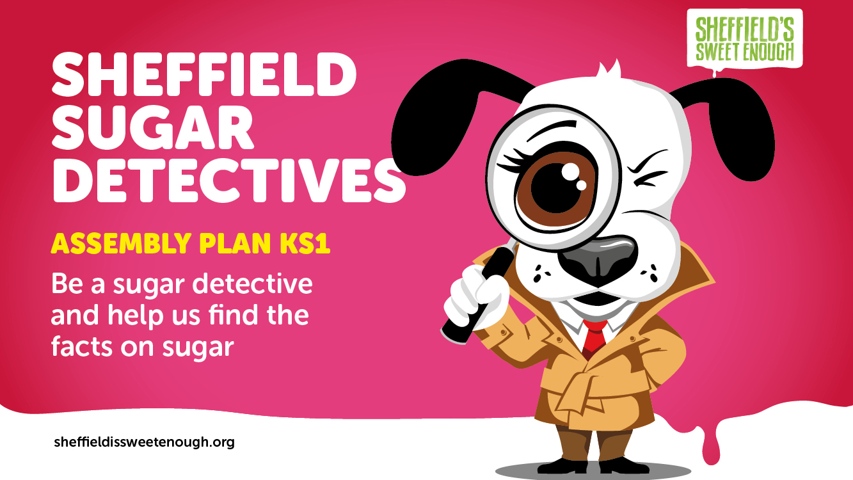
Notes:
Before you start:
You will find an assembly pack of items to download and print. These include:
‘Sugar Heroes’ logo (to print and pin up)
5 x pictures of low sugar foods
5 pictures of high sugar foods
Example of traffic light system

Slide 2
Notes:
In this assembly, we want you to become sugar detectives and find out all about the amount of sugar in food.
You will learn about different types of sugar
How much sugar is too much
The amount of sugar in different foods and drinks
How to spot high sugar items and examples of healthy sugar swaps.

Slide 3
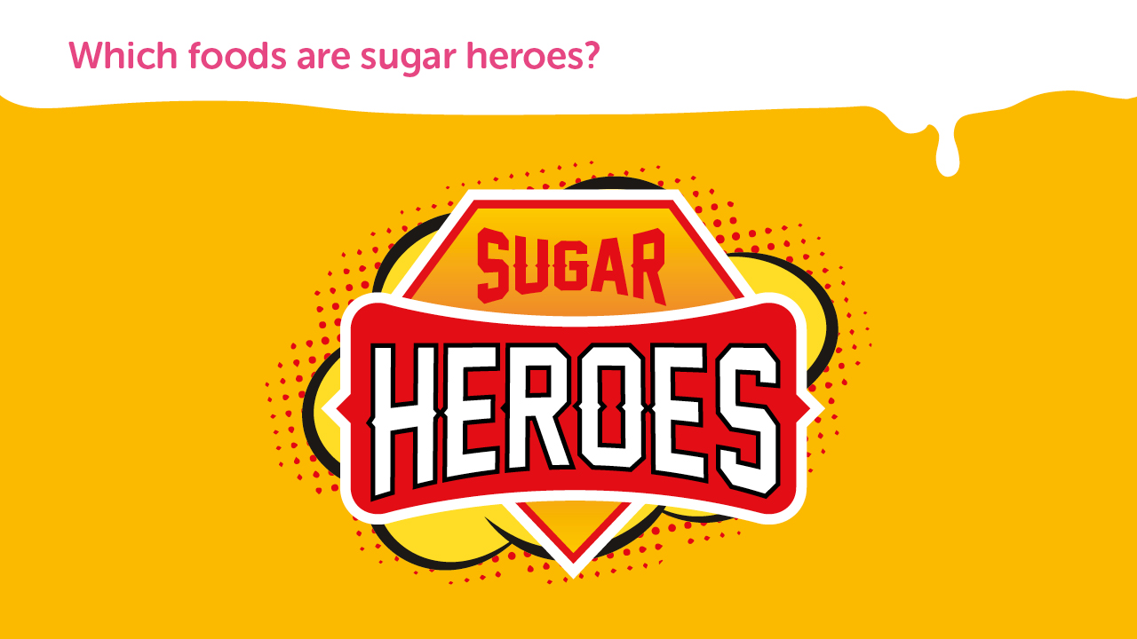
Notes:
Today, we are going to try to find food and drinks that are healthy and don’t contain too much sugar. These are our sugar heroes.

Slide 4
Notes:
There is natural sugar in fruit, vegetables and dairy products.
Put up your hand if you can name a fruit?
How about some vegetables?
And finally, can anyone name a dairy product?

Slide 5
Notes:
Added sugar is any sugar you add to food and drinks to make them taste nicer.
You find added sugar in sweets, biscuits, cakes, pies, pastries, doughnuts, ice cream, flavoured yoghurts and sugar sweetened drinks, such as fizzy drinks, sports drinks, energy drinks or juice drinks.
Do you think these foods are sugar heroes? If not, why not?

Slide 6
Notes:
(Teacher: Stick up a mixture of healthy and unhealthy food pictures around the hall. Select a few children to give you their answers and explain why they think they are healthy).
Children, I need your help to find the healthy food and drink around the hall.
Take a look around and count how many you can see.
Put your hand up when you have an answer.

Slide 7
Notes:
So, we know some food and drinks contain added sugar which isn’t healthy for us.
But does anyone know how much sugar we are allowed to have in a day?
Babies and toddlers should have no added sugar at all.
Children aged 4 to 6 should have no more than 4.5 teaspoons of sugar per day
Children aged 7 to 10 should have no more than 5.5 teaspoons of sugar per day
And anyone over the age of 11 should have no more than 7 teaspoons of sugar a day

Slide 8
Notes:
(Teacher: randomly hand out your ten pictures of food and drink to children in your audience – there should be 5 healthy options and 5 not-so-healthy options).
Now, as we’re playing detectives, I want anyone who is holding onto a sugar hero to come to the front and stand with me.
Hold your picture towards the other children.
(Teacher: Wait until your sugar hero children are in-situ and then see if the other children agree. You can use this as a discussion point if you wish)
Children, do you think (child 1) is right with her picture of (X)?

Slide 9
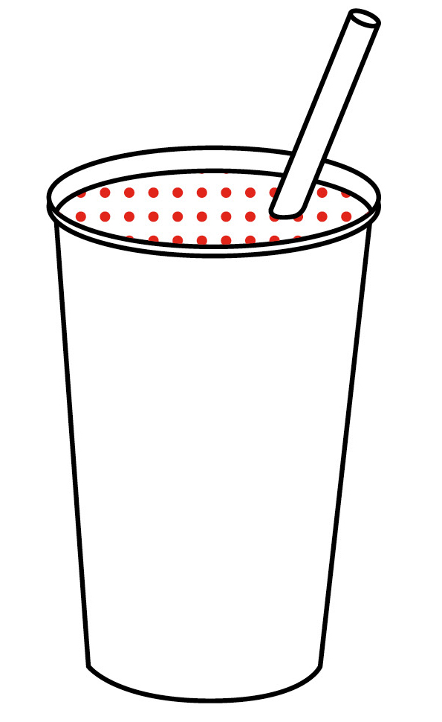
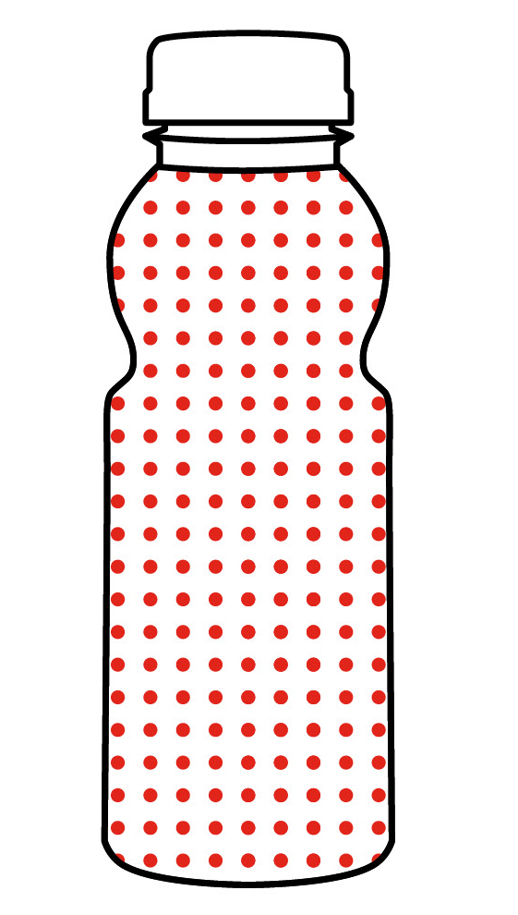
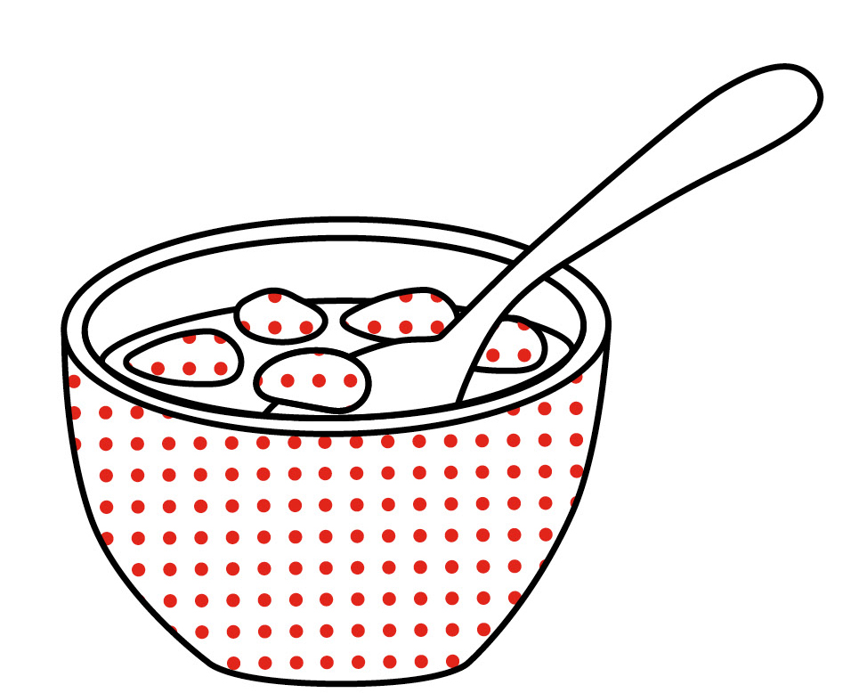
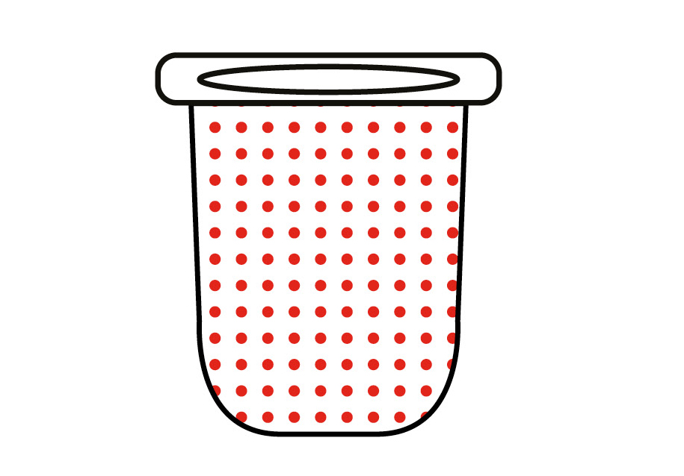
There are some foods that seem healthy, but actually contain a high amount of sugar
Sweetened low-fat yoghurt
6 teaspoons
Fruit smoothie
4 teaspoons
Flavoured water
7 teaspoons
Added-sugar cereal
6 teaspoons
Notes:
(Hopefully the children will have picked some red herrings e.g. low-fat yoghurt)
So, some foods may look healthy but actually they contain a lot of sugar.
Foods with a surprising amount of sugar include low-fat yoghurt, fruit smoothies, flavoured water and sugary cereals.

Slide 10
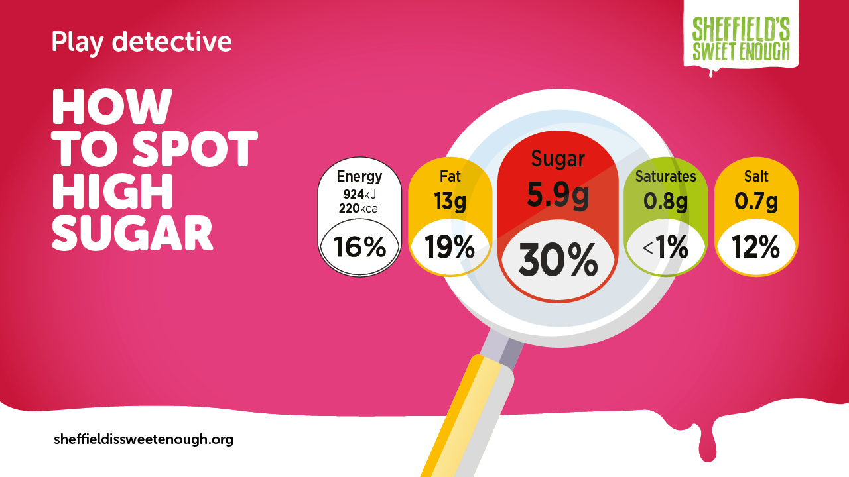
Notes:
So, how can we tell at a glance if some foods contain too much sugar?
Most items of food and drink we buy from the supermarket have a traffic light system on the front.
(Teacher: hold up the traffic light system example)

Slide 11
Notes:
When you go home, have a look at some of the items in your cupboard and you will be able to tell if they are a Sugar Hero by looking at the colour of the sugar content on the packet.
Red means stop and think, this is a high sugar item
Medium means be careful, you shouldn’t eat too much of this
And Green means go ahead, this is a healthier low sugar option

Slide 12
Notes:
Bear in mind, some low sugar items, such as crisps, are high in fat, which is also bad for our health. Low sugar, low salt, low fat is always the healthiest option. Always check the traffic light system for other key ingredients that might be red and amber.

Slide 13
Notes:
When you get home, take a look at your breakfast cereal.
Find out if it is a sugar hero by using the traffic light system.
See if you can find a healthier cereal next time you go to the supermarket.
We hope you’ve enjoyed being a sugar detective and have a learnt a bit more about sugar and how to eat healthily.

