Slide 1
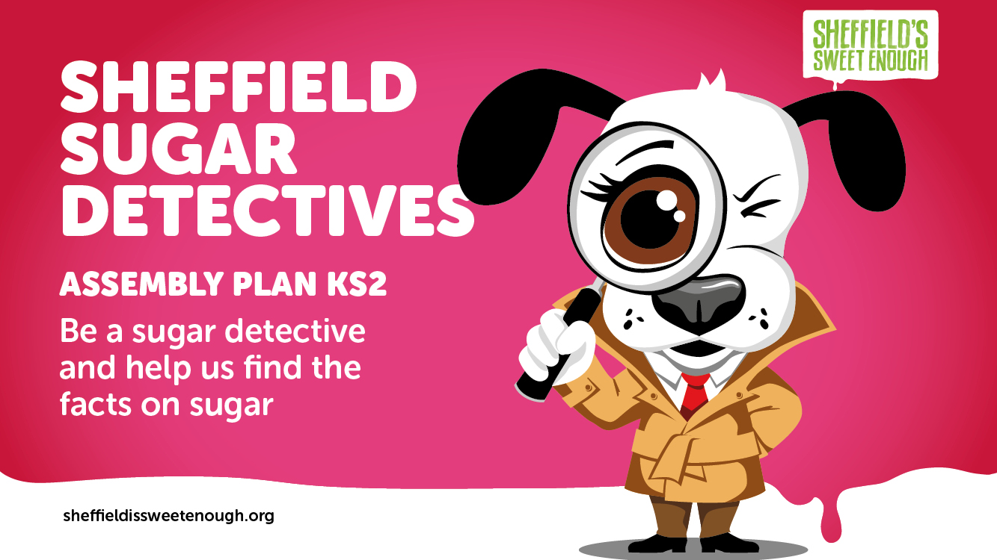
Notes:
Before you start:
You will find an assembly pack of items to download and print. These include:
‘Sugar Suspects’ logo (to print and pin up on one side of the hall)
‘Sugar Heroes’ logo (to print and pin up on the other side of the hall)
5 x pictures of ‘Sugar Suspects’ (high sugar foods) to be used by your pupil volunteers
5 x pictures of ‘Sugar Heroes’ (low sugar foods) to be used by your pupil volunteers
Numbers 1 to 13 to be placed in front of you on the floor facing the children
Example of traffic light system

Slide 2
Notes:
In this assembly, we want you to become sugar detectives and find out all about the amount of sugar in food.
You will learn about different types of sugar – the ‘heroes’ and the ‘suspects’
How much sugar is too much
The amount of sugar in different foods and drinks
How to identify sugar items and examples of healthy sugar swaps.

Slide 3
Notes:
First, I’d like to explain why too much sugar is bad for us.
We need to eat a balanced diet to stay healthy.
Our bodies need a mixture of five main food groups every day. These include carbohydrates, which are things like bread and potatoes, fruits and vegetables, protein from meat and fish, dairy products, such as cheese and milk, and some healthy fats.
Sugar is a carbohydrate that is used by our body as energy.
If we eat too much sugar, it can cause our body to become unbalanced.

Slide 4
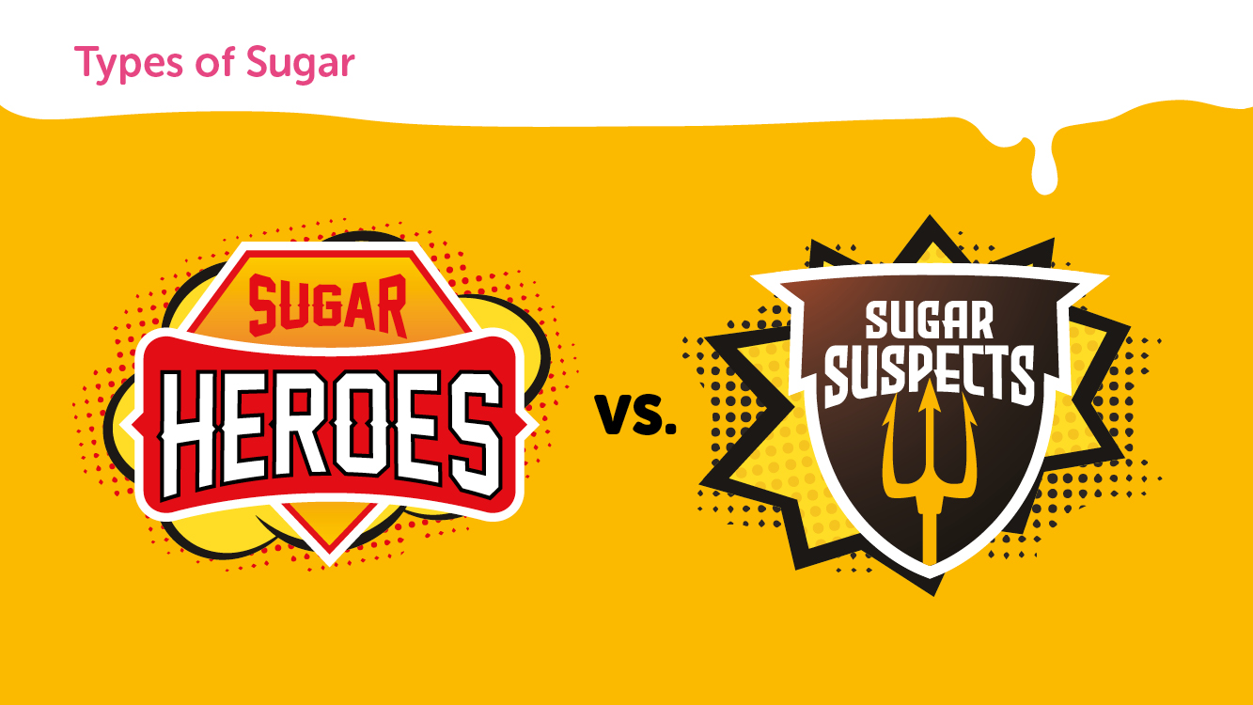
Notes:
Today, we are going to explore which types of sugar are heroes and which ones are the suspects.

Slide 5
Notes:
There are many natural sugar heroes.
Natural sugar can be found in whole, unprocessed foods. These include fruit, vegetables, dairy products and some grains.
Can anyone name some fruits?
How about some vegetables?
And finally, can anyone tell me some dairy products?

Slide 6
Notes:
There is also a long list of sugar suspects.
Added sugar is found in processed food and drinks and any sugar you add to food to make it taste nicer.
Added sugar suspects include sweets, biscuits, cakes, pies, pastries, doughnuts, ice cream, flavoured yoghurts and sugar sweetened drinks, such as fizzy drinks, sports drinks, energy drinks or juice drinks.

Slide 7
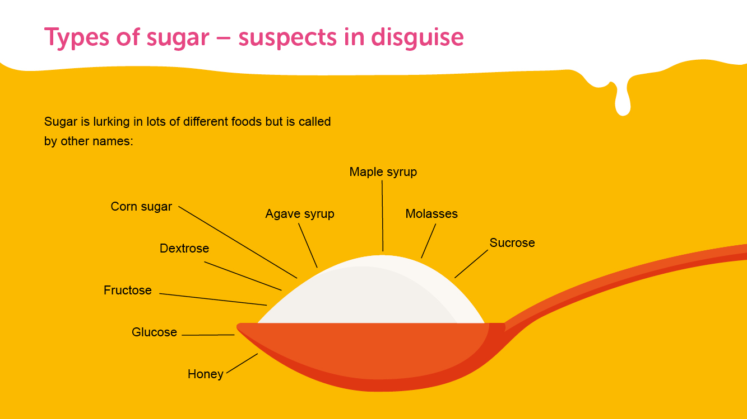
Notes:
Sugar is lurking in lots of different foods but is called by other names so you might not realise you are eating it.
These other names for sugar include maple syrup, corn sugar and even honey.

Slide 8
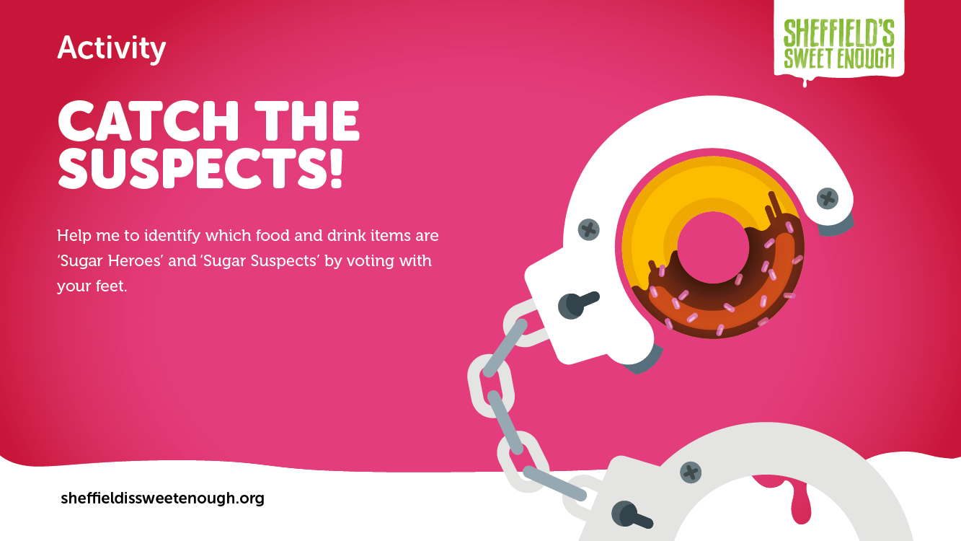
Notes:
(Teacher: This activity can include everyone in the audience or just a select few volunteers. Pick the method that works best for you).
Method 1
I need everyone’s help to identify foods that contain high amounts of sugar and foods that contain low amounts of sugar. The hall has been divided into two sides: Sugar Heroes and Sugar Suspects. I will hold up a picture of an item of food or drink and I want you to go and stand where you think each item belongs.
OR
Method 2
Can I please have ten volunteers. (Teacher: give each child a food/drink picture from your pack)
I’m going to give you each a picture of an item of food or drink and I’d like you to hold these in front of you so that everyone can see. Now, go to the area of the hall where you think your item belongs. If you think it is a high sugar item, stand in the ‘Sugar suspect’ section. If you think it is a low sugar item, stand in the ‘Sugar heroes’ section.
Children, do we think they’ve got it right?

Slide 9
Notes:
Ok, most of you can go and sit down now (Teacher: choose four children to remain standing at the front)
So, we know there are many sugar suspects but how do we know how much sugar is too much? Public Health England recommends a maximum daily limit of sugar in teaspoons per day, depending on how old you are.
Babies and toddlers should have no added sugar at all.
Children aged 4 to 6 should have no more than 4.5 teaspoons of sugar per day
Children aged 7 to 10 should have no more than 5.5 teaspoons of sugar per day
And anyone over the age of 11 should have no more than 7 teaspoons of sugar a day
I’m going to give each of you a picture and I’m going to place the numbers 1 to 13 on the floor in front of me. I’d like you to go and stand on the number of teaspoons of sugar you think your item contains.
(Teacher: give each child one of these pictures: coca cola (answer: 13 tsp), a doughnut (answer: 5.5 tsp) , an ice lolly (answer: 5.75 tsp) and a chocolate bar (answer: 6.5 tsp) and place numbers 1 to 13 on the floor in front of you. Before you reveal the next slide tell the audience what number each child has picked e.g. OK, Charlie has the doughnut and he has chosen 3 teaspoons etc.).
Do you think he’s right?

Slide 10
Notes:
Were the children right? What did they get wrong?
Are you surprised by any of these results?
If 7 to 10 year-olds should have no more than 5.5. teaspoons of sugar per day, which of these food and drink choices would take them over their maximum daily limit?
And what about 4 to 6 year-olds who are only allowed 4.5 teaspoons of sugar per day? Which of these food and drink choices would take them over their maximum daily limit?
That’s right, all of these items contain more than a child’s recommended daily allowance of added sugar.

Slide 11
Notes:
(Teacher: Get ten volunteers back up at the front and hand out images of food and drink. Ask the children to stand in the right order on the numbers 1 to 13).
Now, as we’re playing detectives, I want to put these items in order of most sugary to least sugary.
Can I have ten volunteers back up at the front please?
I need you to help me identify the Sugar Heroes and the Sugar Suspects.
Please take one picture each of an item of food or drink and stand by the number of teaspoons you think they contain from the best low sugar items, at number 1, to the worst high sugar items, at number 10.

Slide 12
Notes:
(Explain the results. Hopefully the children will have picked some red herrings e.g. low-fat yoghurt)
So, you all thought some foods didn’t contain much sugar but in fact, they aren’t as innocent as they look.
Foods with a surprising amount of sugar include low-fat yoghurt, fruit smoothies, flavoured water and sugary cereals.

Slide 13
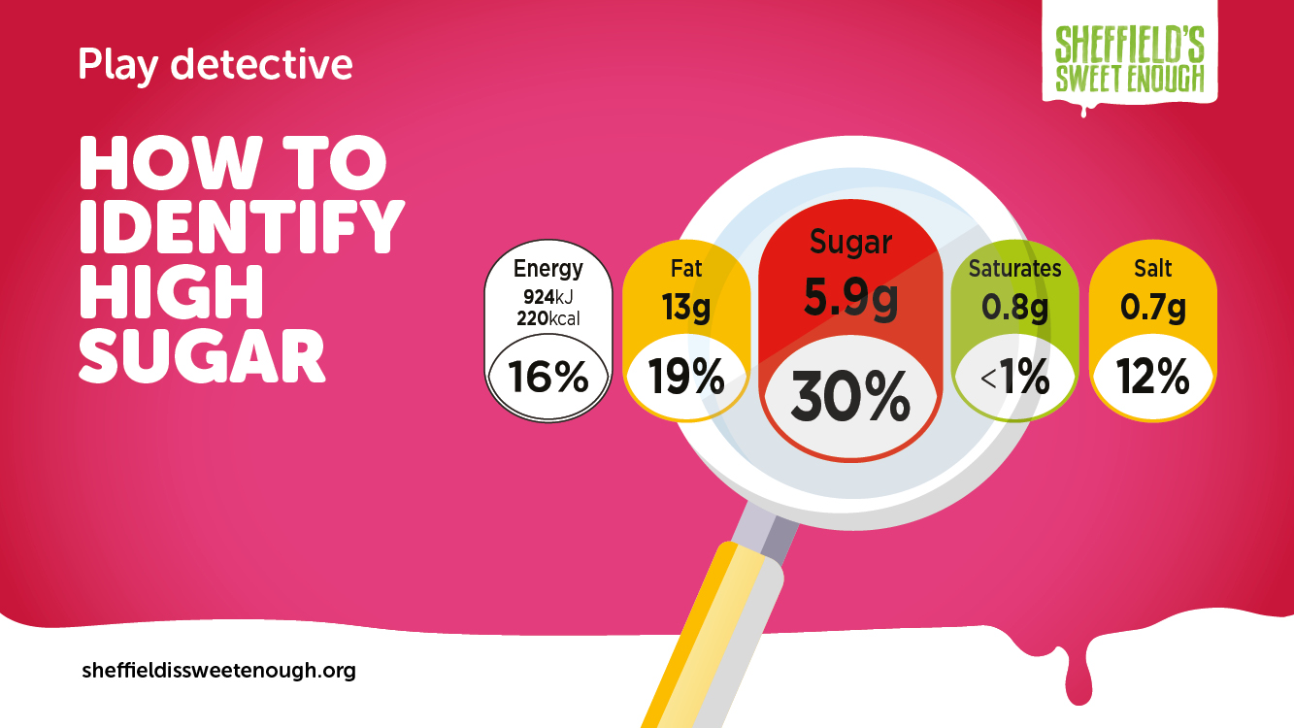
Notes:
So, how can we tell at a glance if some foods contain too much sugar?
Most items of food and drink we buy from the supermarket have a traffic light system on the front.
(Teacher: hold up the traffic light system example)

Slide 14
Notes:
When you go home, have a look at some of the items in your cupboard and you will be able to tell if they are a Sugar Hero or a Sugar Suspect by looking at the colour of the sugar content on the packet.
Red means stop and think, this is a high sugar item
Medium means proceed with caution, this item is OK in moderation
And Green means go ahead, this is a healthier low sugar option

Slide 15
Notes:
Bear in mind, some low sugar items, such as crisps, are high in fat, which is also bad for our health. Low sugar, low salt, low fat is always the healthiest option. Always check the traffic light system for other key ingredients in red and amber.

Slide 16
Notes:
(Teacher: your volunteers should still be standing at the front holding up their pictures of food and drink)
Look at the food and drink items the children are holding up. Which ‘suspects’ could be swapped with ‘heroes’ to make a healthier choice?
For example, you could swap cola with water.
Do you have any other ideas for sugar swaps?

Slide 17
Notes:
Teacher: this is just for fun and is optional
When you get home, why not see if you can identify any sugar heroes or sugar suspect.
Make a list of five items in your cupboard or fridge.
Find out whether they are a sugar hero or sugar suspect using the traffic light system.
Make some suggestions for healthy sugar swaps.
We hope you’ve enjoyed being a sugar detective and have a learnt a bit more about sugar and how to eat healthily.

